Slide 1
Ms. Maiorini
5th Grade Inclusion Teacher

Slide 2
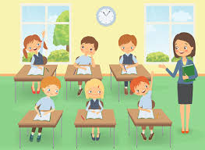
WELCOME TO 5TH GRADE

Slide 3
Follow your dreams!
FOLLOW YOUR DREAMS!!
Every student in our classroom is a CHAMPION!! Each one of you in this classroom has the ability to achieve greatness. We work hard and we work together. There isn’t anything you can’t do. We are here to push you to greatness and watch you have a successful school year.

